Slide 1

THE CONVOLUTED WORLD OF TRAVEL VACCINE SCHEDULING

Slide 2
Let’s start with some rules….

Slide 3
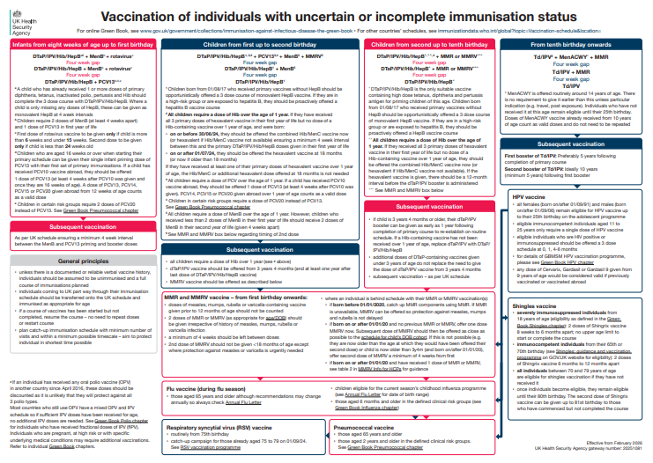
General Vaccination Principles Handy Tips

Slide 4
General Vaccination Principles Handy Tips
Unless there is a documented or reliable verbal vaccine history, individuals should be assumed to be unimmunised and a full course of immunisations planned
Individuals coming to UK part way through their immunisation schedule should be transferred onto the UK schedule and immunised as appropriate for age
If a course of vaccines has been started but not completed, resume the course – no need to repeat doses or restart courses
Plan catch-up immunisation schedule with minimum number of visits and within a minimum possible timescale – aim to protect individual in shortest time possible
Notes:
Many are interchangeable (BUT NOT ALL – twinrix for example, more about that later)
VFR’s common – eg polio MMR under 12m or single measles or patches
Exceptions to re-starting – MMR hep B non responder, vivotif and dukoral, wbc transplants
Travel is often last minute…

Slide 5
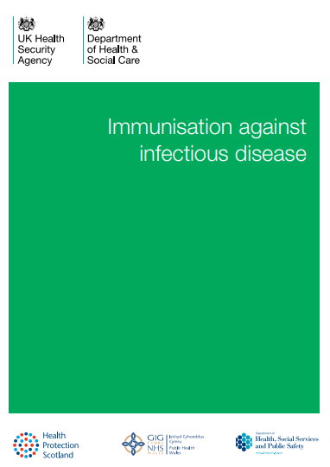
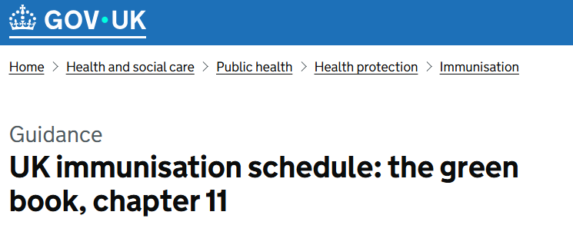
General Vaccination Principles Handy Tips
Doses of different inactivated vaccines can usually be administered at any time before, after, or at the same time as each other, unless stated otherwise.
Doses of inactivated vaccines can also be given at any interval before, after, or at the same time as a live vaccine and vice versa.
Notes:
Eg preference for RSV and flu to be separated on older adult programme (not in younger ppl)
And
Pertussis and RSV for pregnancy (which are naturally scheduled differently anyway)
Covid in past – explain

Slide 6
General Vaccination Principles Handy Tips
A minimum four-week interval is normally recommended between successive doses of the same vaccine. Although shorter intervals may be advised to achieve more rapid protection, e.g. for travel or during an outbreak, this may lead to a lower immune response, particularly in infants, and may therefore provide less durable protection.
If one of the primary immunisation DTaP-containing vaccine doses is inadvertently or deliberately given up to a week early (such as for travel) however, the impact on the final response is minimal.
If more than one dose in the three-dose schedule is given early, or one of the doses is given at less than a three-week interval, then that dose should be repeated at least four weeks after the final dose.
Notes:
Accelerated rabies hep b 12m doses = boosters?
Careful with pgd here

Slide 7
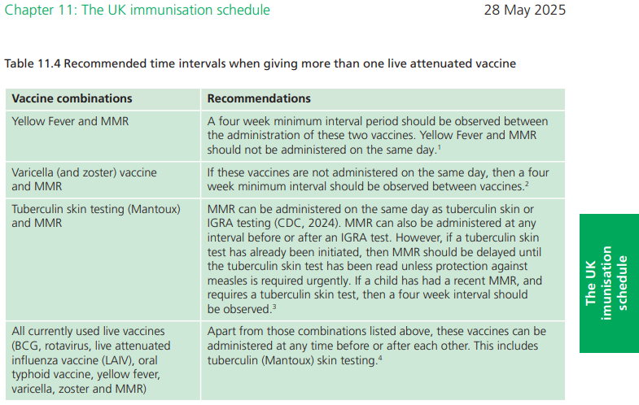
General Vaccination Principles Handy Tips
Notes:
Doesn’t yet mention chik or dengue or vaxchora … or mpox (live non replicating)
Why a month apart yf / mmr?

Slide 8
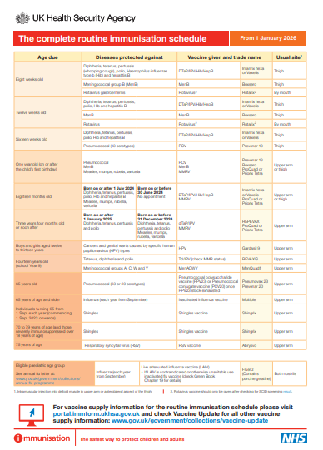
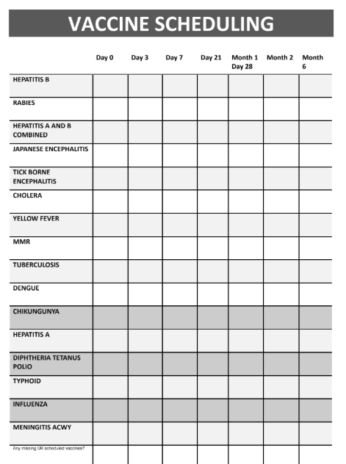

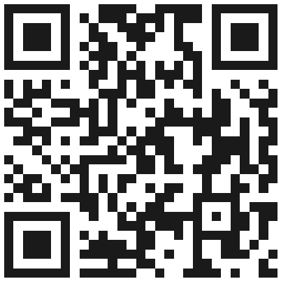
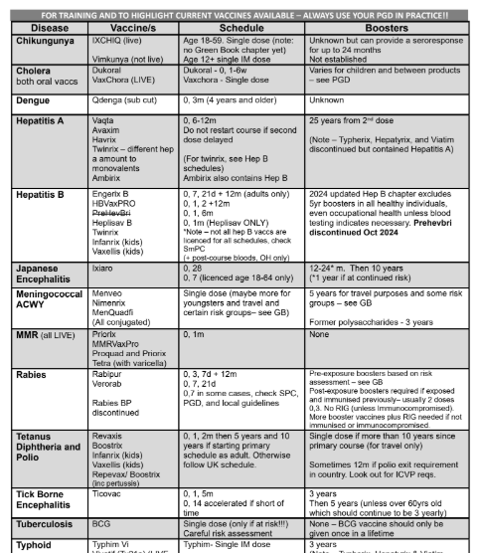
The thing about travel is that you’re often sorting out multiple vaccine schedules whilst juggling multiple variables!
Notes:
It’s really handy to have some quick tools around for arranging lots of vaccine schedules.
In travel health often you have quite a few to start at once. And remember a lot of schedules and rules!
So - Also mention the vaccine cheat sheets that me and jane have

Slide 9
Approach in a logical way to make the best schedule decisions. Start with multidose vaccines to plot your visits. Then plan rest of appointments around them.
Vaccines with accelerated versions of schedules should only be given accelerated if time doesn’t allow the longer schedule (E.G. if time for 0, 28 of a TBE course, do not give 0, 14 as first choice)
Some people are very last minute and scheduling choices are limited. Many can be given at once if necessary. And it’s rarely too late to start…
Nuances common! Some people just want as many out of the way as possible first, some want to wait for pay day, some have small deltoids and can’t physically fit a lot in at once.
Notes:
how to use effectively – eg have a pile printed off and easily accessible or have one that’s laminated so it is a wipeable surface or have a template on the desktop if doing it electronically.

Slide 10
Some want them really spaced out due to cost or needle phobia
MINIMUM intervals - don’t worry if the appointments can’t quite be squeezed in on exactly the right day. Delays = ok, earlier is more of an issue to be avoided
Your colleagues (or other clinics) may be giving the following vaccines in a course - and possibly other vaccines - document the plan clearly. Remember there are several different ways to correctly schedule vaccines.
Outbreaks can lead to shortages, deviations in schedules, protocols, and administration routes (usually just as you finally think you know what you’re doing!)

Slide 11

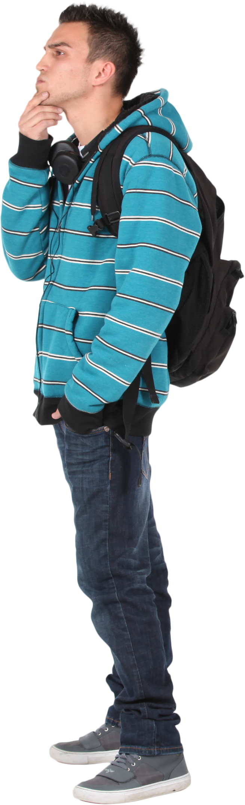
Rob is 25 years old and will be travelling to Peru to complete a high altitude 5-day Inca trail trek to Machu Picchu. Camping along route. He will be in Peru for three weeks in total. He’s considering a 2-day jungle excursion in the amazon (Puerto Maldonado) and aims to stay flexible.
Arriving and departing from Cusco City. Leaving in 3 months. Has trekked in the Alps in Europe previously.
No travel vaccine history. Medically well. Has definitely not had MMR as parents declined it. But has had all other routine UK immunisations.
No health concerns, not on any medication. No history of Dengue.
Traveller Example
Meet Rob! →
Notes:
Example of an activity on my foundation course

Slide 12
 | Decided to have | Considering | Not considering
Chikungunya |  | x
Hepatitis B |  |  | x
Rabies | x
Japanese Encephalitis |  |  | x
Tick Borne Encephalitis |  |  | x
Cholera |  |  | x
Dengue |  |  | x
Yellow Fever | x
MMR | x
Typhoid | x
Hepatitis A | x
Diphtheria Tetanus Polio | x
Meningococcal ACWY |  |  | x
Tuberculosis |  |  | x

Slide 13
Vaccines | Day 0 | Day 3 | Day 7 | Day 21 | Month 1 Day 28 | Month 2 | Month 6
Rabies
Yellow Fever
MMR
Typhoid
Hepatitis A
Diphtheria Tetanus Polio
Anything else? Flu? Chik? MenB? Mpox?
Curveballs!
Fitting in multiple visits to potentially different providers
Cost implications?
Deltoid space?
Announces bitten by a dog 2 months ago in Turkey
What’s the plan for Rob?
Notes:
Start as if doing all, then move to limited providers
Adding chik – perhaps preference for vimkunya – no advantage to live at this late stage – still good immediate immunogenicity
What if he had BCG – separate arms for 3 months after

Slide 14

Vaccines | Day 0 | Day 3 | Day 7 | Day 21 | Month 1 Day 28 | Month 2 | Month 6
Rabies | x |  |  |  | x | x
Yellow Fever |  |  |  |  |  | x
MMR | x |  |  |  | x
Typhoid |  |  |  |  | x
Hepatitis A | x
Diphtheria Tetanus Polio |  |  |  |  |  | x
Anything else? Flu? Chik? MenB? Mpox?
Restrictions? Minimising visits in times of chaos!

Slide 15
Vaccines | Day 0 | Day 3 | Day 7 | Day 21 | Month 1 Day 28 | Month 2 | Month 12
Rabies | x | x | x |  |  |  | x
Yellow Fever * |  |  | x
MMR * | x |  |  |  | X (careful)
Typhoid | x
Hepatitis A |  | x
Diphtheria Tetanus Polio |  | x
Anything else? Flu? Chik? MenB? Mpox?
Last minute travel. What if Rob decides to go in 9 days?
*”Co-administration of these two vaccines can lead to sub-optimal antibody responses to yellow fever, mumps and rubella antigens (Nascimento et. al, 2011). Where protection is required rapidly then the vaccines should be given at any interval; an additional dose of MMR should be considered”. Ch 11 Green Book
Notes:
If two live vaccines are given on different days but within 4 weeks:
The first vaccine induces innate immune responses (interferon etc.)
What do interferons do?
They basically tell surrounding cells:
“Virus incoming — lock down now.”
They cause nearby cells to:
switch on antiviral genes
reduce viral replication ability
make it harder for viruses to enter cells
activate natural killer cells
So the body becomes temporarily resistant to viral replication
This may blunt replication of the second vaccine virus
Result = potentially reduced immunogenicity
That’s the theoretical concern.

Slide 16

Traveller Example
12m later… Rob’s back! →
A year later Rob decides to travel to India, a flexible and rural trip. 4 months travelling. Leaving in 3 weeks.
He has come back to get more vaccine advice. He did not follow up on the MMR2 after his last trip.
Let’s take a quick look at his next visit

Slide 17
Vaccines | Day 0 | Day 3 | Day 7 | Day 21 | Month 1 Day 28 | Month 2 | Month 6
Hepatitis B | x |  | x | x
Rabies (had 0, 3, 7) |  |  | x
Japanese Encephalitis | x |  | x
Yellow Fever
MMR2 |  |  |  | x
Typhoid (had last year, got 3 years from that dose)
Hepatitis A 2 |  |  |  | x
Diphtheria Tetanus Polio
What could Rob’s next clinic visits look like?

Slide 18
Thank you for your attention!
(see you again in a bit for a deep dive into hepatitis A!)
Happy to answer any questions

