Slide 1

Hepatitis A And the most complicated simple vaccine!
Notes:
Hepatitis A is one of the oldest travel vaccines we use…one of the most effective…and one of the most misunderstood in clinic
thanks to improved sanitation, many UK adults are now completely susceptible
It’s quietly one of the big success stories of immunology

Slide 2


Meet our virussy foe, Hepatitis A
Non-enveloped RNA virus
Faecal–oral transmission
Incubation averages 28-30 days
Severe in adults, usually mild in children- often asymptomatic
Notes:
This image represents hepatitis A virus particles
small, non-enveloped, single-stranded RNA viruses with a tough protein capsid (shell).
non-enveloped viruses:
Are resistant to drying
Survive on surfaces longer
Tolerate acidic environments (like the stomach)
Are harder to inactivate
Fit through a lot of water filters
Because they lack a lipid envelope, they’re environmentally resilient, surviving in contaminated food, water, and on surfaces, which explains their efficient
faecal–oral transmission.
After ingestion, the virus travels via the bloodstream to the liver, infecting hepatocytes.
The liver injury we see clinically is largely immune-mediated rather than directly cytotoxic.
Patients typically develop non-specific symptoms of fatigue, nausea, low-grade fever, and right upper quadrant discomfort, followed — particularly in adults — by jaundice, dark urine, pale stools, and pruritus as bilirubin handling becomes impaired.
Most infectious before you feel ill. peak infectivity:1–2 weeks before jaundice. Which explains why outbreaks spread easily
Disease severity increases with age, which underpins the importance of vaccination in at-risk groups.
Can be asymptomatic in kids. Clinical cases of hepatitis A are uncommon among adults living in countries where hepatitis is highly endemic, as most people are exposed to the virus at a young age and acquire lifelong immunity.

Slide 3
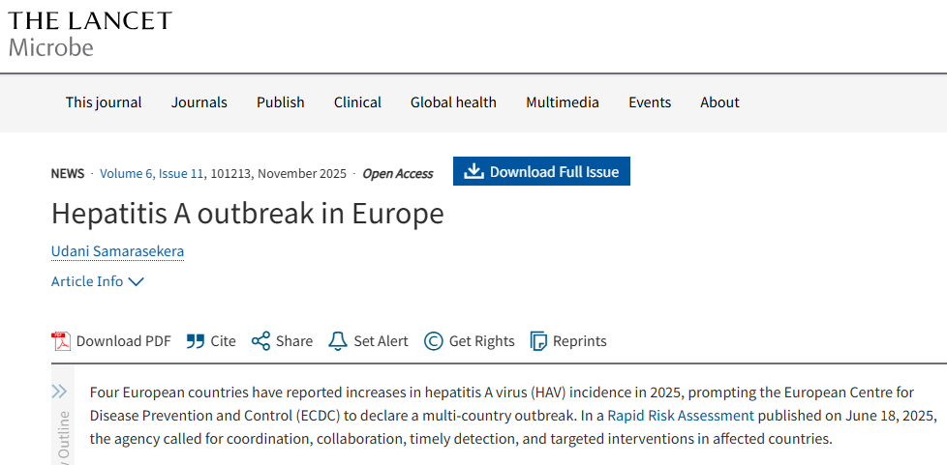
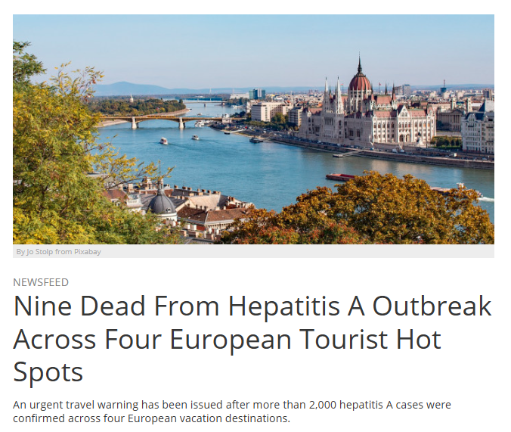
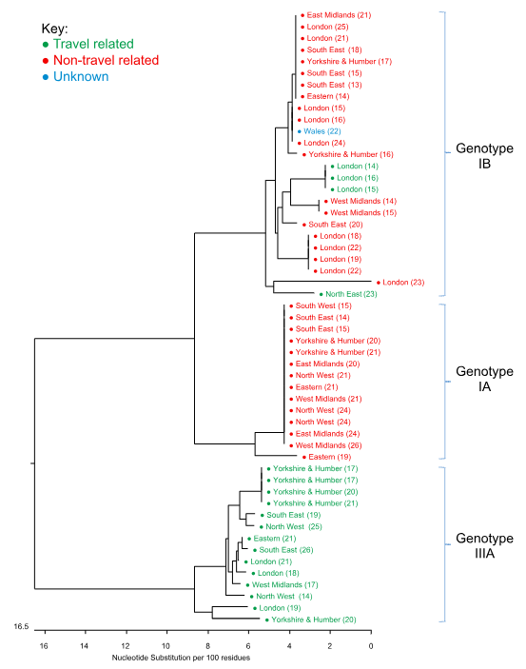
Why are we talking about Hepatitis A?
Global burden: ~1.4 million reported cases annually worldwide (at least)
Endemic transmission persists in parts of Africa, Asia, and Latin America due to sanitation gaps
Large foodborne outbreaks continue to occur globally via imported produce and frozen foods- and of course, travel
Notes:
Hep A isn’t “just tropical.”
Worldwide, approximately 1.4 million cases of hepatitis A are reported every year, but the true incidence is likely to be 3–10 times higher [NaTHNaC, 2023].

Slide 4
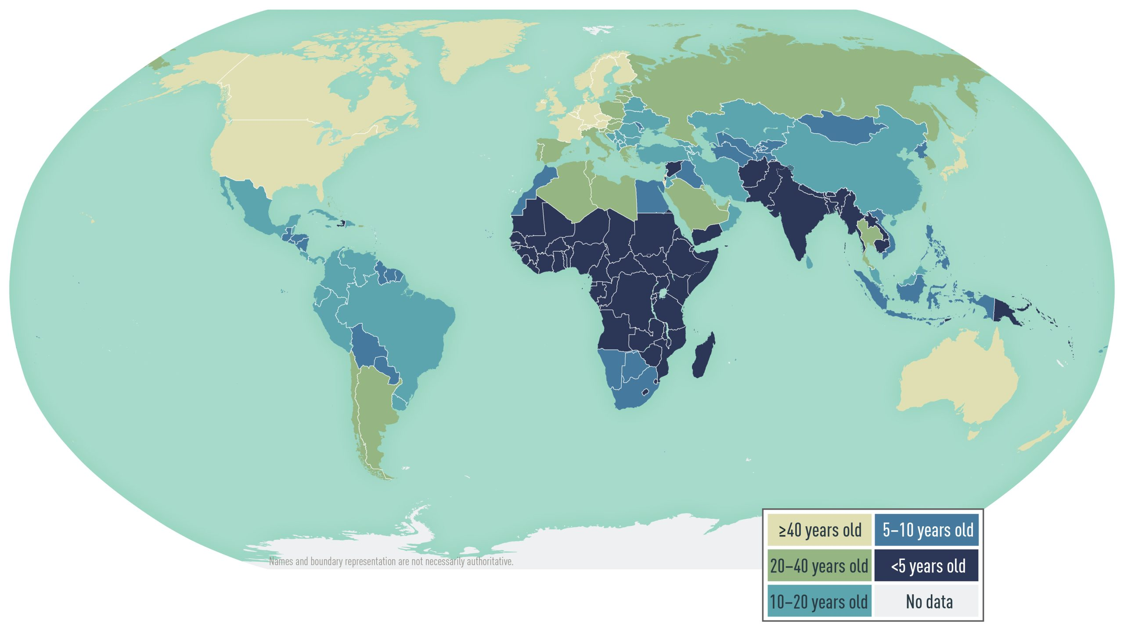
Why is Hepatitis A a problem for the UK? (ever wondered why the vaccine is given on the NHS?)
~300–500 UK reported cases per year (BUT over 800 lab-confirmed cases reported in E&W 2024)
Significant MSM outbreaks across the UK and Europe 2016-2018
Cyclical outbreaks every few years as population susceptibility in non-endemic regions accumulates
Hits adults harder. Low childhood exposure = increasing adult susceptibility and more symptomatic disease
Notes:
A significant MSM outbreak between 2016–2018 involved ~670 confirmed cases
we ran into major vaccine supply shortages in 2017 because of this.
At the same time the US also had big outbreaks amongst drug users and homeless people causing a surge in global vaccine demand.
Unlike some vaccines, production can’t be rapidly scaled up in response to sudden demand – take months to produce
The 2017 shortages remind us that hepatitis A may be quiet for years
- but when outbreaks occur in susceptible adult populations, demand for vaccine rises rapidly and globally

Slide 5
https://www.cdc.gov/yellow-book/hcp/travel-associated-infections-diseases/hepatitis-a.html
Notes:
Because endemic exposure is very low here in the UK, we don’t build natural immunity in childhood - most adults remain susceptible - which means when outbreaks occur, they hit adults harder.
This means we do end up giving a lot of hep a vaccines for travel !

Slide 6
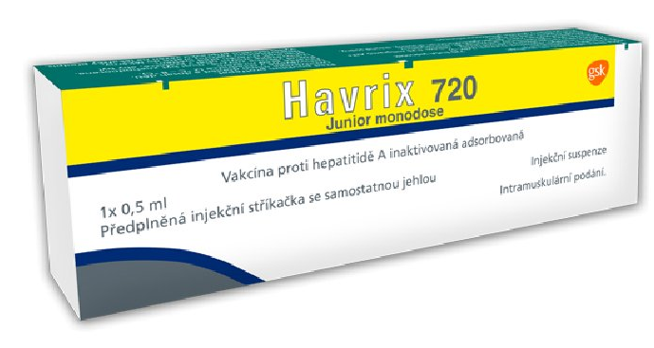
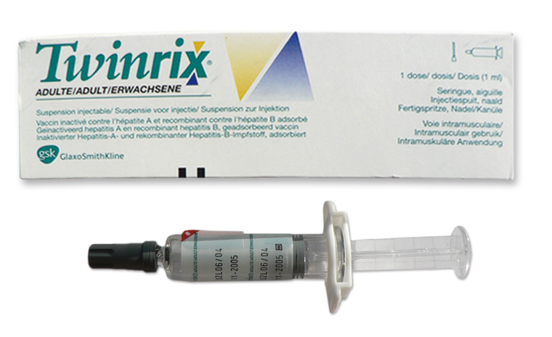
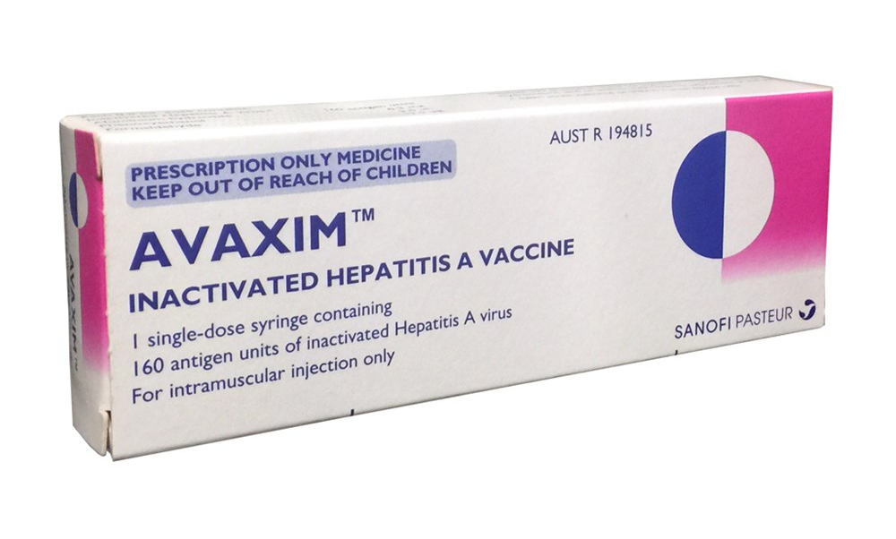
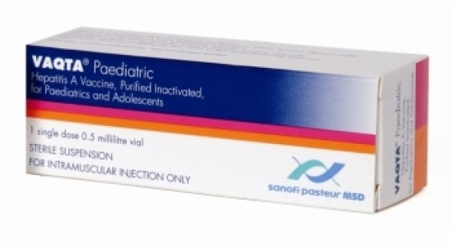
Let’s talk about the vaccines!
Notes:
Most of the clinical errors reported to the nathnac helpline were hep a or b errors
A brief history of Vaccine Development
Initially HNIG then
Early 1990s: inactivated whole-virus vaccines developed (1992)
Rates declined 95.5% in America since vaccination initiation in 1996 to 2011
Originally, adult Hep A vaccination used:
➡ 720 ELISA units x 2 or 3 doses (1st two sometimes a month apart) (i.e. two paediatric-strength doses)
Then in 1996, GSK introduced:
➡ Havrix 1440 0, 6-12m
Which allowed:
✔ A full adult primary dose in a single injection ✔ Same antigen content (1440 EL.U) ✔ Simpler schedule ✔ Fewer injections
Vaqta came in 1996 then
Combination vaccines later introduced
The vaccine hasn’t changed much — but our understanding of duration has.

Slide 7

Sarah (29) received one dose of monovalent Hepatitis A vaccine in 2017 before travelling to Thailand. She is now travelling to Morocco in 4 weeks. She never returned for her second dose.
So…It’s been 9 years — shall we restart the course? What do you think?
Second dose now?
Or Restart?
Notes:
Warm up question

Slide 8

Daniel (22) is travelling to India. He had two paediatric Hep A vaccines aged 13 and 14. A colleague says; “Those were child doses - he needs adult ones now.”
So…what do you think?
Repeat whole course using adult vaccines?
One adult booster?
Nothing – he’s nicely protected?
Notes:
No need to restart because dose was “child strength”.
Immune memory is immune memory.
Children respond really well to the vaccines
antigen content appropriate for age, not a “weaker” vaccine.
The misunderstanding comes from confusing dose volume with immune priming quality.

Slide 9
Knowing a bit of Immunology really helps here
(and some key ‘rules’)
First dose = primes immune memory
Seroconversion >95% within 2–4 weeks
Second dose = durability
Evidence suggests protection at least 25 years, likely lifelong, after two doses (of age-appropriate vaccine). Even one dose gives long-lasting protection.
If a second dose is delayed by years, the general rule is that we do NOT restart.
Notes:
Adress what do we do after that 25 years?

Slide 10
HOWEVER… when DO you ‘start again’?
Had HNIG, not vaccine
If given Havrix prior to mid 1990’s when the antigen content was lower, you don’t need to start entirely again, but treat 2 doses given 1 month apart as one dose (primed) rather than a complete course of two (basically - check the intervals given at).
Those with certain immunosuppressive conditions may not respond well to the vaccines and may benefit from extra doses or earlier boosting. Be on the look out for such occasions!
ANY uncertainty about prior vaccine history (as per the algorithm for those with uncertain or incomplete vaccine histories)
Notes:
In the past Havrix might have been given as two doses a month apart of a 720 ELISA vaccine for ‘first dose’. Therefore, if you see 2 early Havrix in the notes 0,1m. this is considered 1 full dose. Of you see 0 1 6 havrix 720 then its 25 years from last dose.

Slide 11

Aisha received 2 doses of Twinrix in 2021 (0 and 1 month). She never returned for the 6-month dose. She is travelling again next month to Mexico. Hepatitis B risk seems to be relatively low.
So…what do you do?
Give a monovalent Hepatitis A vaccine to finish the course?
Give another Twinrix to complete the course?
Start again with 2 monovalent Hepatitis A doses?
Notes:
Rule here - try to complete courses (even better if on same vaccine) if they have been started already
Another rule – monovalent and twinrix – never the twain shall meet!

Slide 12
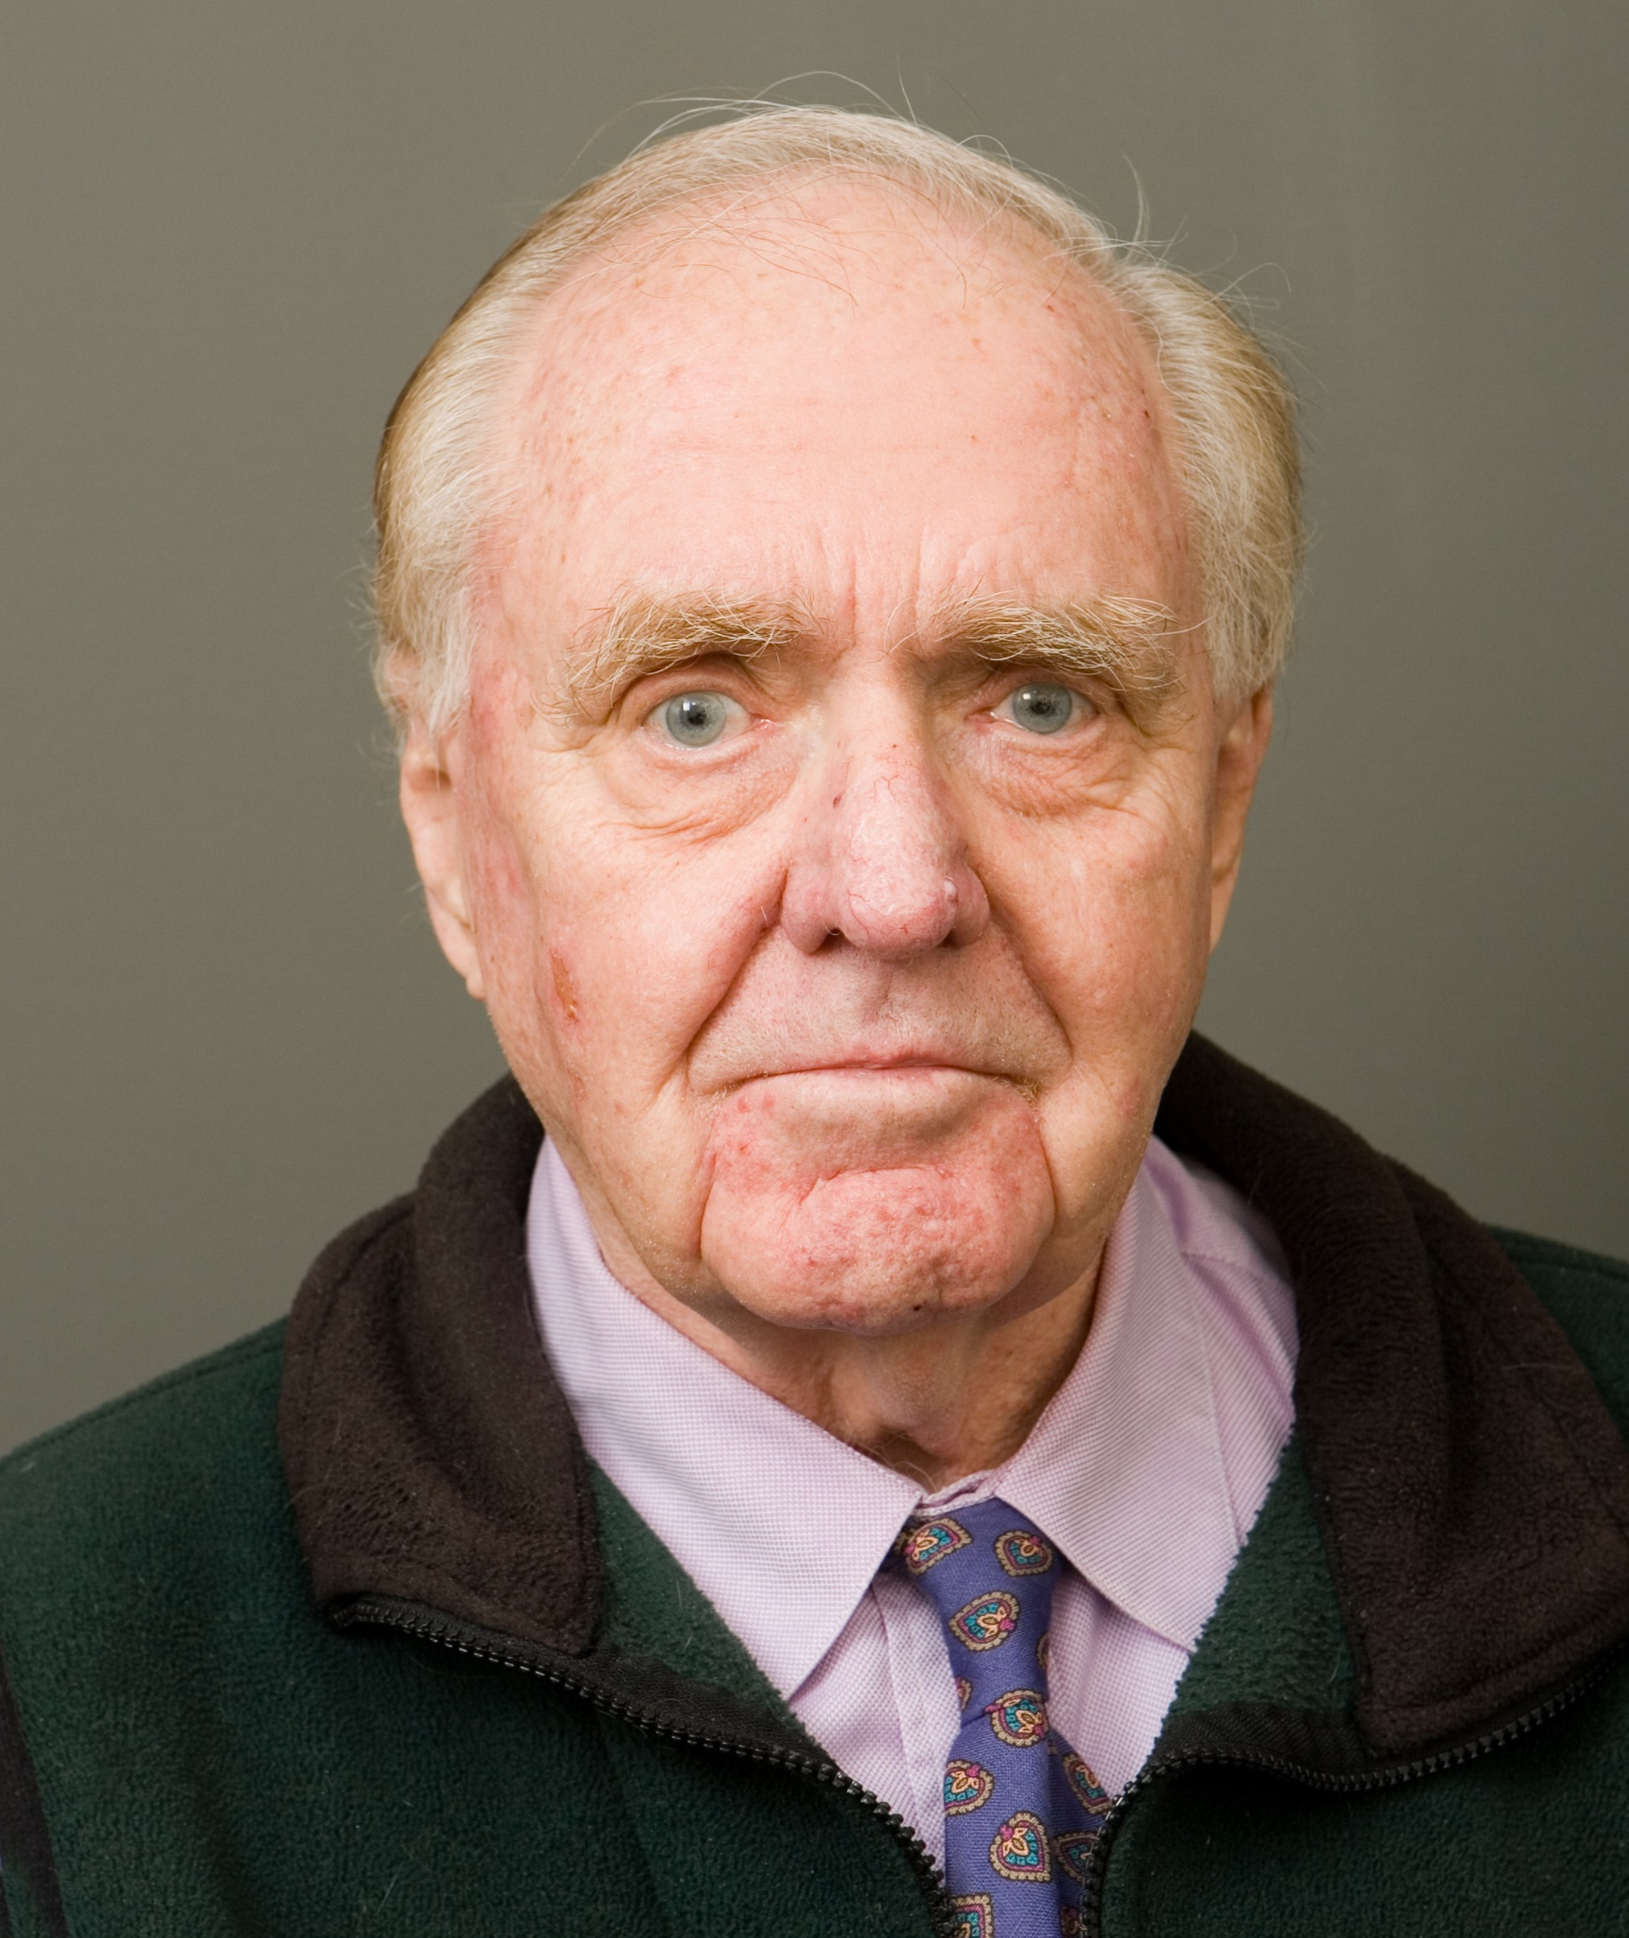
Mr Walker started on accelerated Twinrix in 2019, but at the time he only had the 0 and 7 day vaccines. He presents in 2026 for travel. You give a third dose now (because you remembered the not-restarting rule, well done!).
BUT what do you advise about future vaccines?
Which is it?
Because there was a large gap you can dismiss the gap between the initial accelerated doses and class that as 3 doses = course complete?
Advise a final (fourth) dose of twinrix at around 12 months?
See what his risk is at the time and give either a hep B or a hep A monovalent at the time if he doesn’t need both?
Notes:
Finish his course. Boosters are different. The 12m is part of the course.

Slide 13

Green book says “Until further evidence is available, reinforcing immunisation with a booster 25 years after a completed hepatitis A vaccine course with standard dose is therefore generally not needed except for those at ongoing risk or post-exposure to a person with hepatitis A.”
Jack has reached 25 years since the second dose of Hepatitis A. He is off to Cambodia for 2 months on a shoestring backpacking trip. He had Havrix for his primary course in 2001, and the SPC for Havrix says there’s no need to boost further after 2 doses.
What would you do here?
Nothing. The SPC says not to boost?
Give a booster because of ‘ongoing risk’ as per Green Book, but only if you have Havrix in stock?
Give a booster of any monovalent Hepatitis A vaccine?
BUT
Exact quote
“Current recommendations do not support the need for further booster vaccination among immunocompetent subjects after a 2-dose vaccination course” https://www.medicines.org.uk/emc/product/1158/smpc#gref
Notes:
Rule : Follow JCVI green book over spc

Slide 14

Henry was raised in South Africa and was unwell with Hepatitis A (the disease) as a child. He has documented serology evidence of this as he went to hospital with it, and his parents kept meticulous medical records.
What do you advise about Hepatitis A vaccines?
Give him the vaccines, it won’t do any harm?
Omit the vaccines – he will likely have good immunity from the previous infection already?
“Following clearance of hepatitis A infection patients acquire lifelong immunity.” https://travelhealthpro.org.uk/factsheet/21/hepatitis-a

Slide 15

Jenny is leaving tomorrow to a high endemicity area for Hepatitis A, and will be there for 3 weeks.
So, what do you advise re vaccines? Is she too late?
Offer vaccine?
Too late, no point in vaccinating?
GREEN BOOK says, “For travellers, vaccine should preferably be given at least 2 weeks before departure, but can be given up to the day of departure. Although antibodies may not be detectable for 12–15 days following administration of monovalent hepatitis A vaccine, the vaccine may provide some protection before antibodies can be detected using current assays.” P6
Notes:
Incubation 28-30 days range 15-50 days

Slide 16

Rita had Epaxal in 2000 and ViATIM in 2010. She’s now off to live in India for 3 months on an extended work trip.
Is she sufficiently protected against Hepatitis A?
Yes?
No?
Notes:
Hepatyrix is another past vaccine you might see in the notes - Twinrix solved a bigger travel problem than typhoid did.
So if you were going to give “a combo”…Twinrix usually won. Hence demand dropped for combo hep a /typh
Manufacturing of Epaxal (the virosomal Hep A vaccine) was discontinued globally in 2014.
Epaxal used virosome technology (like Inflexal V)- scientifically elegant but: More complex to manufacture More expensive No major clinical advantage over aluminium-adjuvanted Hep A vaccines. With strong competitors already established: HavrixVaqtaAvaxim…it simply stopped making business sense to continue.

Slide 17
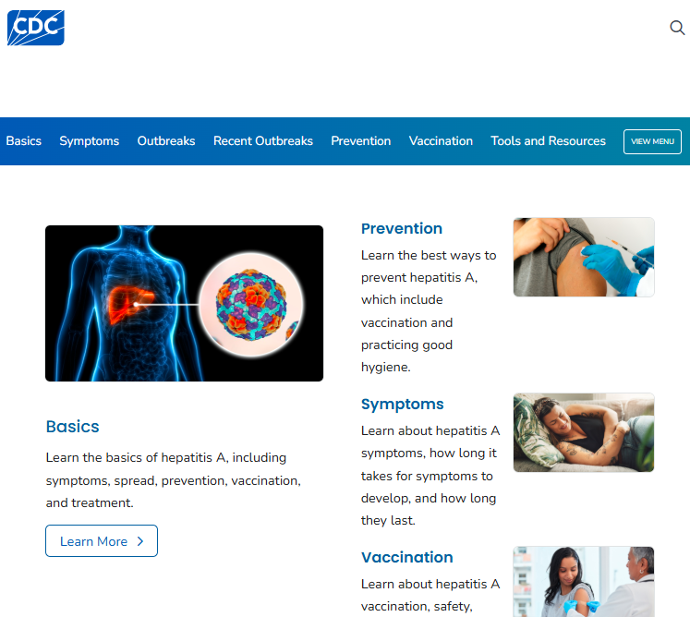
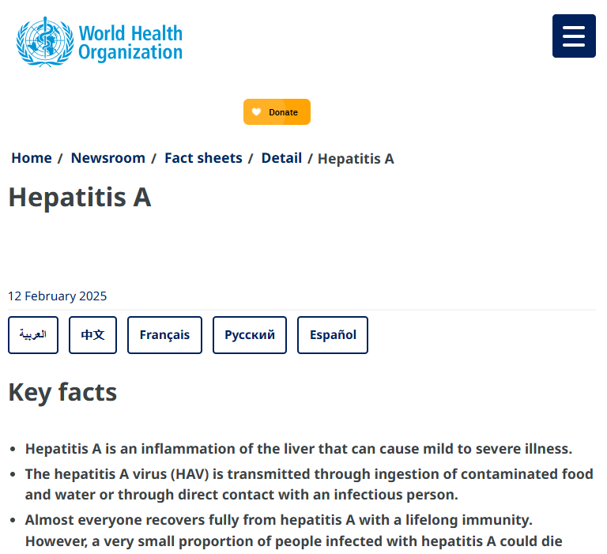
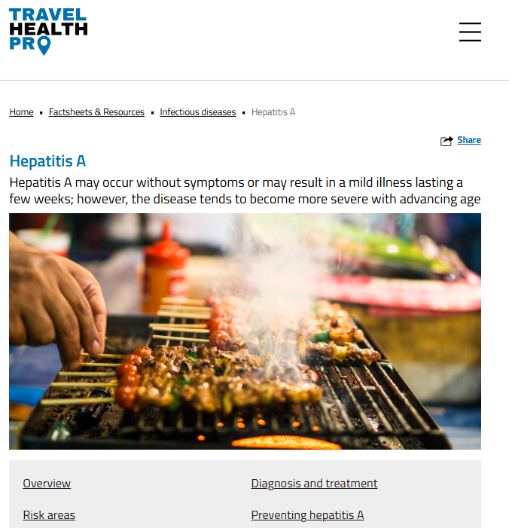
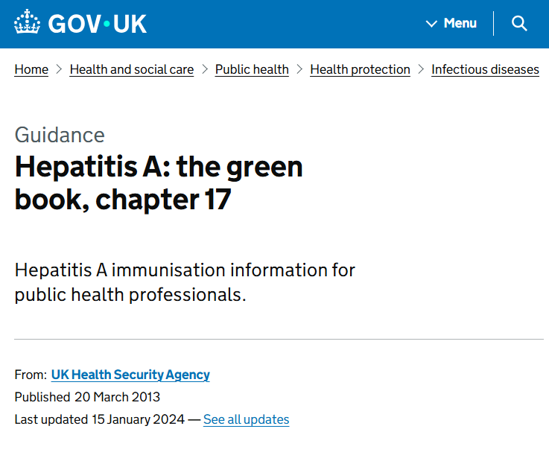
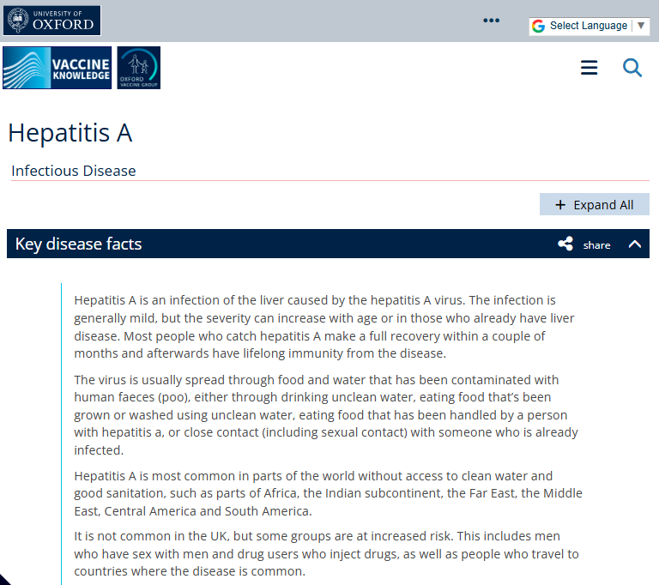
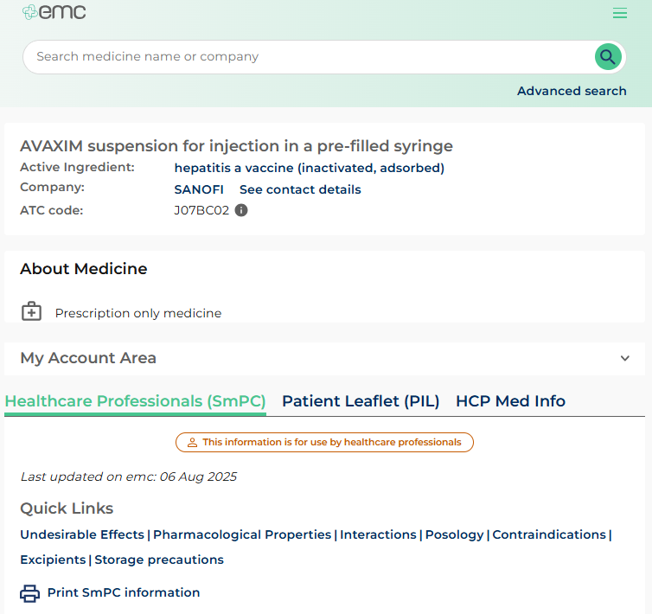
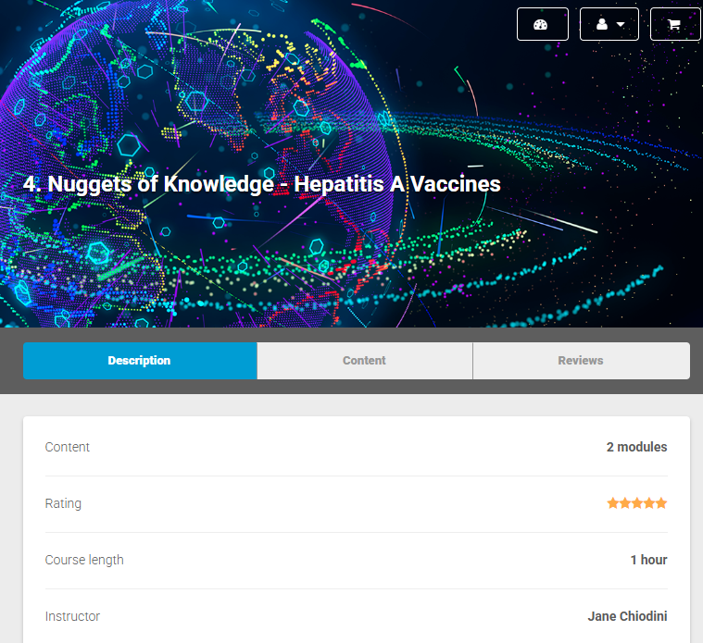
Key resources
Travel Health Pro (NaTHNaC)
CDC & WHO
The Green Book (Ch 17)
The Vaccine Knowledge Project
The emc and your PGD’s
Jane Chiodini try her fabulous FREE course ‘Nuggets of knowledge- Hepatitis A vaccines’
Notes:
All hyperlinked

Slide 18


alyssclassroom.co.uk

Slide 19
Thank you for your attention (again)!
(and for playing your part in reducing Hepatitis A cases in the UK!)

