Slide 1
Learning Workshop Output and Examples

Slide 2
Process Flow Example – How to boil rice
Continued…..

Slide 3
Process Flow Example – How to boil rice

Slide 4
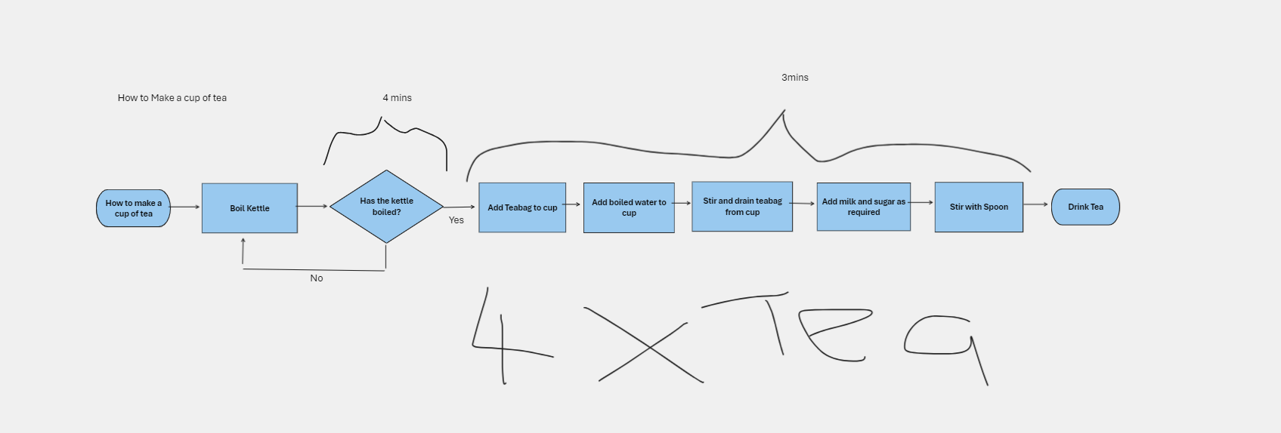
Process Flow Example – Making a cup of tea

Slide 5
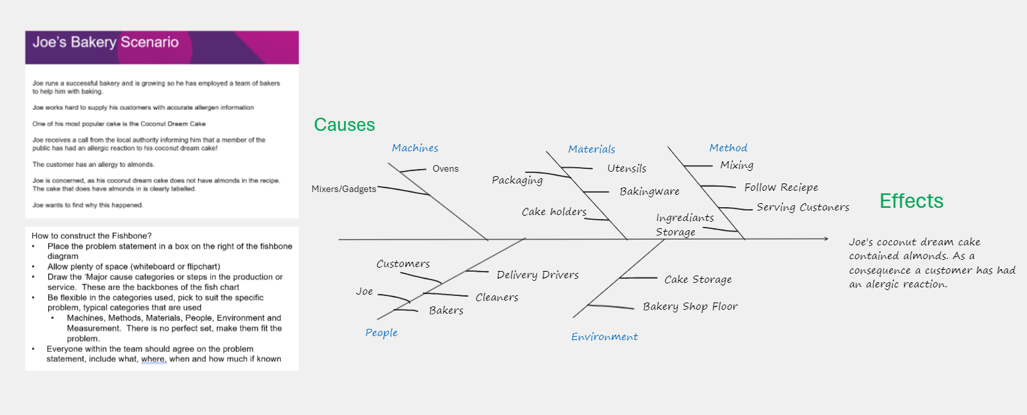
Fishbone Example – Joes Bakery Scenario

Slide 6
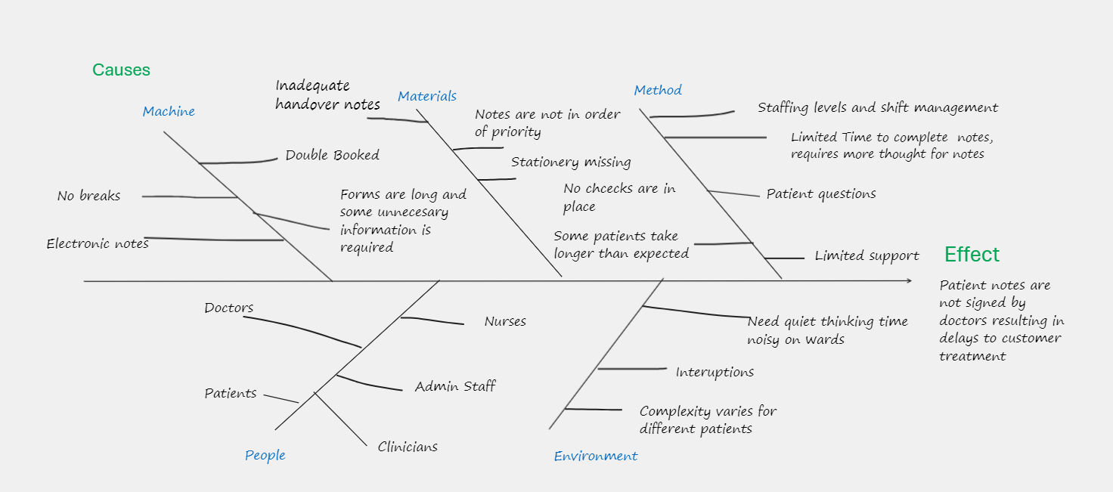
Fishbone Example – Medical Clinic Scenario

Slide 7
5 Y’s Analysis - Example
Problem: Why were almonds added to the coconut cake instead of coconut?
Why1
Why2
Why3
Why4
Why5
The baker couldn’t tell them apart. They both looked similar, and neither were labelled
Why were the ingredients not labelled?
Why were they not replaced?
Why did the baker not spot the error?
Why was the baker unfamiliar with the procedure?
The labels were removed during the last clean and were not replaced.
The cleaning staff didn’t consider the impact of this and didn’t have it on their checklist
He was unfamiliar with the production procedure.
He was trained but no sign off procedure to determine it was satisfactory.

