Slide 1
Social Care Integration Fellowship Programme
Learning Workshop

Slide 2
Agenda
The Role of a Fellow
Project Charter & The Discovery Workbook
The Problem-Solving Approach–Design Thinking
Empathise
Define
Ideate
Test
Prototype
Next Steps

Slide 3
The Role of a Fellow
Fellows will participate part time on improvement projects, normally on projects related to their day-to-day jobs.
They will lead on discovering the root causes of problems in complex processes.
They will become familiar and confident with the tools and techniques to problem solve and use them to identify opportunities within day-to-day tasks.
They may also be effective team members as part of larger programmes of work.

Slide 4
What skills do you need?
Starting a project with the right mindset as well as acquired skills is equally important.
Think about all the duties you carry out in your day-to-day jobs which you can leverage to build new skills:
Planning skills
Communication skills
The ability to document your thoughts
Applying a disciplined attitude to problem solving
The ability to communicate your ideas to your colleagues and peers
Gaining feedback and be open to make changes
Notes:
What skills you need and what are we trying to improve in capability through the learning

Slide 5
The cost of not addressing problems
What we know about bad experiences
We know if 1 person has a concern or bad experience many more will exist who have not voiced the same issue.
An individual with a problem or complaint will tell between 10 and 20 other people both internally and externally. Some of those listeners will be persuaded to avoid the organisation or services they provide.

Slide 6
Additional costs of not addressing problems
Financial
Increased Rework
Increased cost of complaints handling
Patients
Reduced Patient Satisfaction
Damage to Reputation
Effectiveness
Lost productivity
Poor Business Outcomes
Reduced process capacity
Employees
Employee Satisfaction
Poor Morale
Notes:
That was how people are left feeling through a bad experience but there are other costs to not addressing problems

Slide 7
Agenda
The Role of a Fellow
Project Charter & The Discovery Workbook
The Problem-Solving Approach–Design Thinking
Empathise
Define
Ideate
Test
Prototype

Slide 8
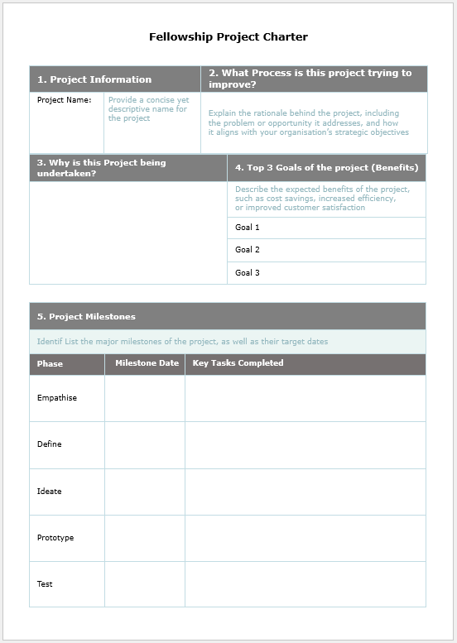
Create a Project Charter
Raising a ‘Project Charter as you start a new initiative is an important first step to ensure the purpose is understood.
Concise summary of key project information
Useful communication tool for stakeholders
Documents initial problem statement
States goals and objectives
Details roles & responsibilities
Sets out project plan & milestones
Signed by Project Sponsor

Slide 9
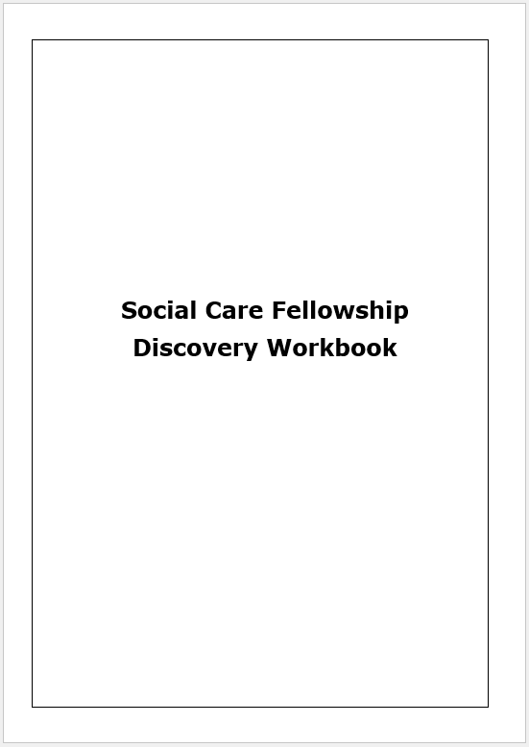
The Discovery Workbook
The Discovery workbook is central place for you to document your journey through the fellowship programme.
Document all activity undertaken within each phase.
Bring it updated to drop-in sessions to help me support you through your individual projects.
Handwritten or typed, your preference is fine
Add more pages if you need to, it’s your workbook and can be as detailed as you need it to be.
At the end of the programme, we will collectively reflect on your individual projects and the programme, your workbook will be a useful resource for reflection.

Slide 10
Agenda
The Role of a Fellow
The Discovery Workbook
The Problem-Solving Approach–Design Thinking
Empathise
Define
Ideate
Test
Prototype

Slide 11
Why the Design Thinking Approach?
A clear structured method and approach.
Driven by lived experiences of fellows and their colleagues
Strong focus on reducing process variation and non-value-added activity
Encourages team-based approach with strong cross functional links
Rigorous measures of improvement for clear success identification
Notes:
Will give you a journey that’s structured and give you the ability to analyse throughout

Slide 12
Introduction into The Design Thinking Approach
Clearly define the problem by collating all available data and information
Document and review the current process.
Brainstorming creative ideas with design thinking application.
Create boundaries to scope where applicable.
Impact assess ideas if required.
Prioritise activity.
Apply analytical skills supported with a suite of tools and techniques to understand root causes.
Create SMART metrics if/where applicable.
Identify impacted stakeholders.
Create a proof of concept.
Align sponsor to support advocating the change or new way or working.
Engage stakeholders.
Implement test solution and gain feedback.
Measure against SMART metrics if set out in Define.
Continually improve the solution by revisiting metrics periodically

Slide 13
Agenda
The Role of a Fellow
The Problem-Solving Approach–Design Thinking
Empathise
Define
Ideate
Test
Prototype

Slide 14
Empathise – Understanding Your People
We want everyone to be engaged and motivated and come to work switched on with a fresh mindset. We need collaboration, dedication and involvement of everyone if we are to truly go ‘From Good to Great’
This is why YOU are so vital. By being on the frontline, you know exactly what the processes are and what issues your teams and patients have. We need to ensure that you realise how important your knowledge is and more importantly what you can do with it!

Slide 15
Build a Network – Team Based Problem Solving
Improvements in any organisation comes through engaging with those who know the process best, YOU and other colleagues with front line experience.
Team Based Problem Solving:
Problem Solving Activity at a local level
Target improvement opportunity in local performance and/or procedures.
Use basic problem-solving tools such as 5 Whys and Fishbone
Can be facilitated by local champion or fellow.
Problems tackled should be low difficulty, low impact issues so easy to apply

Slide 16
Baseline the problem with research
The purpose of the Empathise phase within Design Thinking is to clearly identify and determine the issue to be solved and there after create a Project Charter that will establish a strong position for getting support for a go-forward with the plan from the Champion or Sponsor.
Key Activities
Validate that there is a problem
Identify Stakeholders
Identify Team Members
Work with your team to map out the current service being provided
Identify the metrics available within the process to measure the size of the problem
Any data points that can be measured
Timesheets
Log of emails
Can be approx. figures

Slide 17
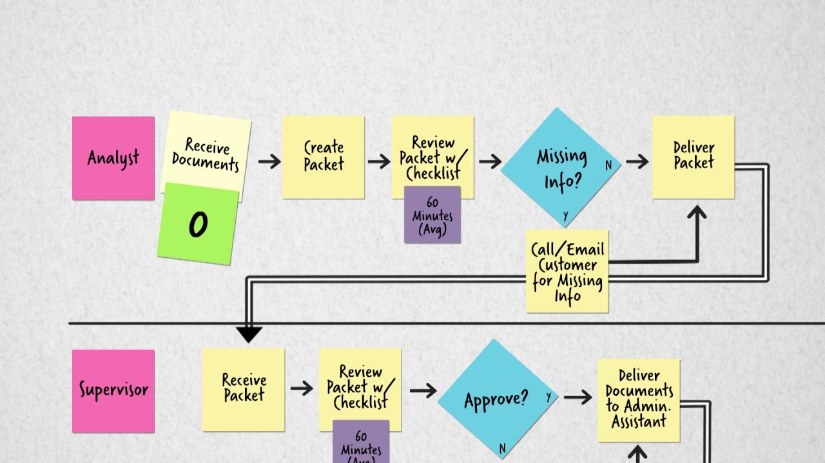
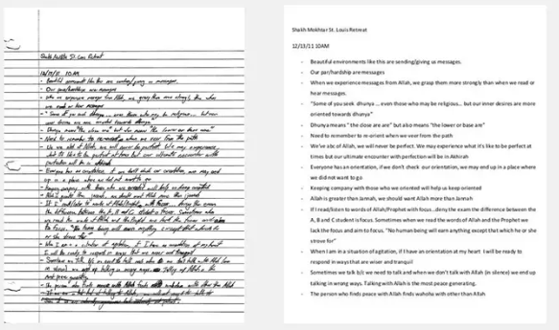
Tools to consider for documenting current state
Process Mapping
Worded Document

Slide 18
Process Mapping Steps
Process mapping is a simple exercise in your toolkit of improvement methods. It helps a team to know where to start making improvements that will have the biggest impact. It creates a visual for stakeholders to understand what steps are within a process or service from start to finish
Symbol
 | Start/End | Start and End of a process
 | Arrows | Connection between 2 steps
 | Process | A step in the process
 | Input/Output | Input or Output within a process
 | Decision | Decision to be made
Name
When to use it?

Slide 19
Agenda
The Role of a Fellow
The Problem-Solving Approach–Design Thinking
Empathise
Define
Ideate
Test
Prototype

Slide 20
Introduction into The Design Thinking Approach
Clearly define the problem by collating all available data and information
Document and review the current process.
Brainstorming creative ideas with design thinking application.
Create boundaries to scope where applicable.
Impact assess ideas if required.
Prioritise activity.
Apply analytical skills supported with a suite of tools and techniques to understand root causes.
Create SMART metrics if/where applicable.
Identify impacted stakeholders.
Create a proof of concept.
Align sponsor to support advocating the change or new way or working.
Engage stakeholders.
Implement test solution and gain feedback.
Measure against SMART metrics if set out in Define.
Continually improve the solution by revisiting metrics periodically

Slide 21
Root Causes of Issues
Metrics and data exist in most organisations which are the initial indicators that identify areas of concern or where improvements should be made.
Once we know that we have a problem we need ways to deep dive into the problem.
The use of some key tools and techniques to understand the issue deeper should be applied before we think about appropriate solutions.

Slide 22
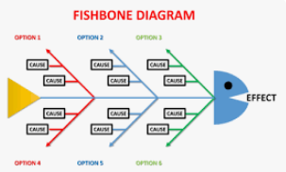
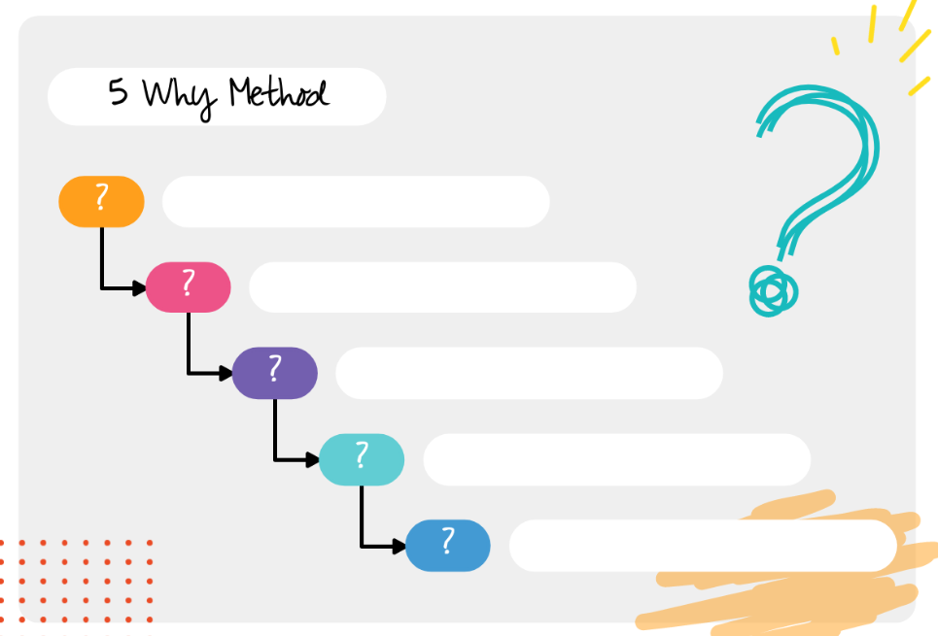
Tools to consider for Root Cause Analysis
Fishbone Tool
The 5 Why’s

Slide 23
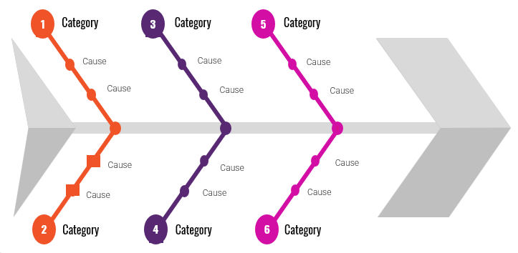
Fishbone Tool – Cause & Effect
The fishbone tool is useful in opening up thinking in problem solving. It creates a snapshot of the collective knowledge and consensus of a team around a problem. This builds support for resulting solutions. It also focuses the team on causes and not symptoms.
How to construct the Fishbone?
Place the problem statement in a box on the right of the fishbone diagram
Allow plenty of space (whiteboard or flipchart)
Draw the ‘Major cause categories or steps in the production or service. These are the backbones of the fish chart
Be flexible in the categories used, pick to suit the specific problem, typical categories that are used
Machines, Methods, Materials, People, Environment and Measurement. There is no perfect set, make them fit the problem.
Everyone within the team should agree on the problem statement, include what, where, when and how much if known

Slide 24
Fishbone Tool – Cause & Effect Template
CAUSES
1
Category
3
Category
EFFECT
PROBLEM
STATEMENT
2
Category
4
Category
5
Category

Slide 25
Joe’s Bakery Scenario
Joe runs a successful bakery and is growing so he has employed a team of bakers to help him with baking.
Joe works hard to supply his customers with accurate allergen information
One of his most popular cake is the Coconut Dream Cake
Joe receives a call from the local authority informing him that a member of the public has had an allergic reaction to his coconut dream cake!
The customer has an allergy to almonds.
Joe is concerned, as his coconut dream cake does not have almonds in the recipe. The cake that does have almonds in is clearly labelled.
Joe wants to find why this happened.

Slide 26
Medical Clinic Scenario
A medical clinic has an ongoing issue with doctors not signing notes prior to treatment starting for a patient.
Various ways to tackle the issue have been introduced like reminders, checklists and communications but it continues to be a problem.
Notes not being signed off leads to staff panicking at the list minute to get notes signed and patients are left waiting for long periods of time before their treatment can be started.

Slide 27
Tools to consider for Root Cause Analysis
Fishbone Tool
The 5 Why’s

Slide 28
5 Y’s Analysis
The 5-Why Analysis is a technique for helping the team to identify the root cause of the problem being analysed.
Pick one possible cause from the Fishbone diagram Analysis
Write it at the top of the sheet
Turn it into a question – Why has this happened? Record the answers in the first column
Repeat the process for each answer, moving across and down the sheet until the root cause is known or the answer to the question is not known
Develop actions to either solve the cause or answer the question.
Problem:
Why1
Why2
Why3
Why4
Why5

Slide 29
5 Y’s Analysis - Example
Problem: Why were almonds added to the coconut cake instead of coconut?
Why1
Why2
Why3
Why4
Why5
The baker couldn’t tell them apart. They both looked similar, and neither were labelled
Why were the ingredients not labelled?
Why were they not replaced?
Why did the baker not spot the error?
Why was the baker unfamiliar with the procedure?
The labels were removed during the last clean and were not replaced.
The cleaning staff didn’t consider the impact of this and didn’t have it on their checklist
He was unfamiliar with the production procedure.
He was trained but no sign off procedure to determine it was satisfactory.

Slide 30
Common Mistakes with 5 Y’s
Common Mistake
Solution
Doing the analysis alone | This requires a team to be effective with different perspectives
Too general: not enough time, poor communication | Ask specific questions that can lead to actionable causes
Jumps to solutions | Ask about the cause which leads you to the solution. Validate your assumptions with frontline
Blames a person | Focus on the process
Focusing on things that are out of your control | See if you can ask the question differently or move on

Slide 31
Agenda
The Role of a Fellow
The Problem-Solving Approach–Design Thinking
Empathise
Define
Ideate
Test
Prototype

Slide 32
Introduction into The Design Thinking Approach
Clearly define the problem by collating all available data and information
Document and review the current process.
Brainstorming creative ideas with design thinking application.
Create boundaries to scope where applicable.
Impact assess ideas if required.
Prioritise activity.
Apply analytical skills supported with a suite of tools and techniques to understand root causes.
Create SMART metrics if/where applicable.
Identify impacted stakeholders.
Create a proof of concept.
Align sponsor to support advocating the change or new way or working.
Engage stakeholders.
Implement test solution and gain feedback.
Measure against SMART metrics if set out in Define.
Continually improve the solution by revisiting metrics periodically

Slide 33
Ideate – How do we Brainstorm new ideas?
Brainstorming is a technique which encourages creative thinking and idea generation.
A workshop environment is proven to be effective for generating ideas.
3. Quantity not Quality
4. Facilitator
Key Requirements for a successful session:
Set goals ahead of time
Choose the right team, mix SMEs with outsiders for
broader views and ideas.
Choose quantity over quality (you can eliminate ideas that are not achievable.
Ensure you have a facilitator; it can be you or ask for help who is good communicator.
Start with ice breaker(s) (try to get people thinking outside of their work duties)
Stick to a timer for each topic
2. Choose Team
5. Ice Breaker
1. Set Goals
6. Timer

Slide 34
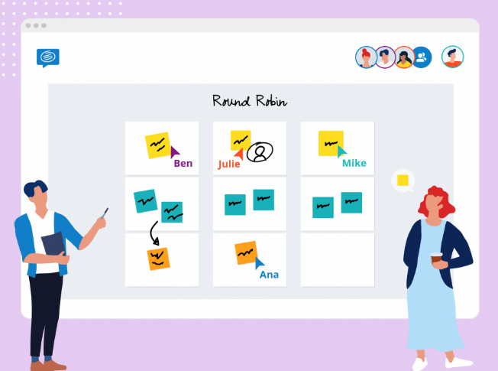
Round Robin Brainstorming
Round Robin brainstorming is a process in which everyone involved is given an equal chance of free-thinking and generating their ideas about a specific problem without any restrictions. It is one of the best-known techniques to solve creative problems. Group discussions will generate ideas from different perspectives and will highlight both strengths and weaknesses of an idea or solution.
Key Elements for a successful brainstorming session:
Set the scene with the topic use visuals or flipchart where possible and post it notes for different ideas/elements
Ensure you work around the room and all attendees participate.
No idea is a bad idea, no judgements within the room on comments and ideas.
Keep a relaxed atmosphere.
Take a break if needed and come back to the topic.
Limit evaluation, use the time to create as many ideas as possible
5. Ice Breaker
6. Timer

Slide 35
Project Scope Considerations
The next phase will require you as a fellow to consider the options presented through the brainstorming activity. Bringing the project team together for this activity will be beneficial including your project mentor so ideas can be reviewed and agreed to take forwards. The group should consider all ideas and agree specific scope that is clear and achievable.
Considerations when scoping your project:
Does the idea meet your objectives?
What value does the project have to the business?
Can it be completed in an appropriate timescale?
What are the consequences of not doing it?
What resources will be required?
Is the time, right?
5. Ice Breaker
6. Timer

Slide 36
In/Out Scoping Tool/Method
xxx
xxx
How does it work?
Engage with Project Team and Sponsor for session to work through ideas.
Stick all the ideas down on a Flip Chart
Draw a Large Circle on the flip chart
Discuss Each element with team
In scope goes in the circle
Out of Scope stays outside
Use as a visual to agree with sponsor and those involved.
xxx
xxx
xxx
xxx
xxx
xxx
xxx
xxx
xxx
xxx
xxx
xxx
xxx
xxx
xxx
xxx
xxx
xxx
xxx
xxx
xxx
xxx

Slide 37
Agenda
The Role of a Fellow
Project Charter & The Discovery Workbook
The Problem-Solving Approach–Design Thinking
Empathise
Define
Ideate
Test
Prototype
Next Steps

Slide 38
Introduction into The Design Thinking Approach
Clearly define the problem by collating all available data and information
Document and review the current process.
Brainstorming creative ideas with design thinking application.
Create boundaries to scope where applicable.
Impact assess ideas if required.
Prioritise activity.
Apply analytical skills supported with a suite of tools and techniques to understand root causes.
Create SMART metrics if/where applicable.
Identify impacted stakeholders.
Create a proof of concept.
Align sponsor to support advocating the change or new way or working.
Engage stakeholders.
Implement test solution and gain feedback.
Measure against SMART metrics if set out in Define.
Continually improve the solution by revisiting metrics periodically

Slide 39
Document the Prototype (new solution)
Process Mapping
Worded Document

Slide 40
Prototype - Document the proposed new solution
Using the skill’s you have developed to process map an existing process or service, document the Prototype or new way of working.
Key Actions:
Document the new solution (using a process map)
Share with key stakeholders for agreement and support in advocating change.
Document actions and owners that are required to be completed prior to a test solution to go live.
Add risks to risk log and raise with mentor as required.

Slide 41
Importance of Communication
Communication ensures that everyone is on the same page and working towards the same improvement.
Effective communication leads to better decision making and problem solving.
Collaborate with your project sponsor on communications to ensure the messaging is appropriate and has their support.
Communication promotes better relationships and understanding of the changes with those who are impacted.
Give clear guidance to those impacted on what to do if they require support or have questions on the change.
Poor communication can result in misunderstandings, delays and errors.

Slide 42
Introduction into The Design Thinking Approach
Clearly define the problem by collating all available data and information
Document and review the current process.
Brainstorming creative ideas with design thinking application.
Create boundaries to scope where applicable.
Impact assess ideas if required.
Prioritise activity.
Apply analytical skills supported with a suite of tools and techniques to understand root causes.
Create SMART metrics if/where applicable.
Identify impacted stakeholders.
Create a proof of concept.
Align sponsor to support advocating the change or new way or working.
Engage stakeholders.
Implement test solution and gain feedback.
Measure against SMART metrics if set out in Define.
Continually improve the solution by revisiting metrics periodically

Slide 43
Test the new solution
Testing should be explained to be experimental to all impacted parties
Keep it small and manageable
Keep key stakeholders and impacted parties updated with progress
Request feedback at key points through the test phase
Provide a quick and easy way for everyone to feedback how the testing is progressing.
Document all feedback and findings.

Slide 44
How do we measure the success?
Reflect on your Project Charter and the objectives you set out.
Measure your new activity using the same baseline metrics identified in the ‘Empathise’ phase
What do the new metrics tell you?
Use the route cause analysis tools to dig deeper again if you need to uncover additional problems.
Adjust or make changes to the solution.
Repeat the test and learn approach until the solution is achieves the desired objectives.
Keep key stakeholders and impacted parties updated with progress throughout.

Slide 45
Helpful Hints
Find time to reflect on the project and document what are thinking and your key learnings.
Good practise is to document as you go along through each phase and then more holistically at the end of the project.
Use your discovery workbook to guide you through the project
Take photos of any work carried out on boards or flipcharts for reflection and them to your workbooks.
List what went well for you and what you would want to improve if you were to start again.
5. Ice Breaker
6. Timer

Slide 46
Questions and your thoughts……
?

Slide 47
Next Steps
It’s time to make a start on your improvement idea!
Allocate the half day in your diaries for each week to focus on the project you are undertaking w/c 19th Feb through to w/c 29th July
Start with your project charter and get it updated as far as you can and identify elements that you need support on.
Meet with your project mentor to talk through your approach and key milestones. Using this time walk your mentor though the design thinking methodology so they will understand a little better the approach you are taking within the project.
Attend 30 min drop-in sessions with Sheetal Mistry commencing W/c 4th March
Time in the first week of Aug will be booked for a 121 session (30mins) and a separate group session (1 hr) to reflect on your projects and their outcomes.
5. Ice Breaker
6. Timer

